Slide 1
CHAPTER 1

Slide 2


Slide 3
What is AI?
Historically, researchers have pursued several different versions of AI.
Some have defined intelligence in terms of fidelity to human performance, while others prefer an abstract, formal definition of intelligence called rationality—loosely speaking, doing the “right thing.”

Slide 4
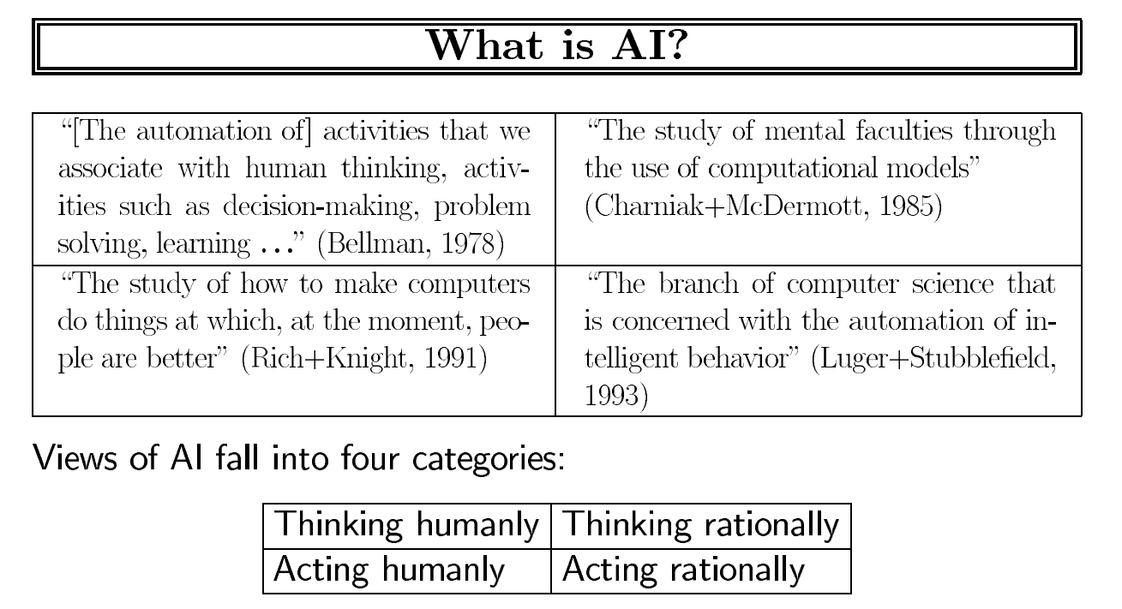

Slide 5
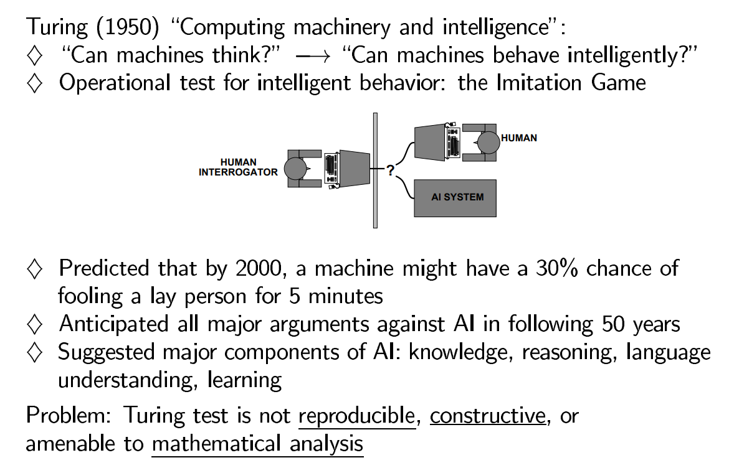

Slide 6
A computer passes the test if a human interrogator, after posing some written questions, cannot tell whether the written responses come from a person or from a computer.
The computer would need the following capabilities:
Natural language processing
Knowledge representation
Automated reasoning
Machine learning
Notes:
Natural language processing to communicate successfully in a human language;
Knowledge representation to store what it knows or hears;
Automated reasoning to answer questions and to draw new conclusions;
Machine learning to adapt to new circumstances and to detect and extrapolate patterns.

Slide 7
Turing viewed the physical simulation of a person as unnecessary to demonstrate intelligence. However, other researchers have proposed a total Turing test, which requires interaction with objects and people in the real world.
To pass the total Turing test, a robot will also need to know
5.Computer vision and
6.Speech recognition to perceive the world;
These six disciplines compose most of AI.
The quest for “artificial flight” succeeded when engineers and inventors stopped imitating birds and started using wind tunnels and learning about aerodynamics.

Slide 8
Video links:
The Turing test: Can a computer pass for a human? - Alex Gendler (youtube.com)
ChatGPT BROKE the TURING TEST - New Era Begins! (youtube.com)

Slide 9
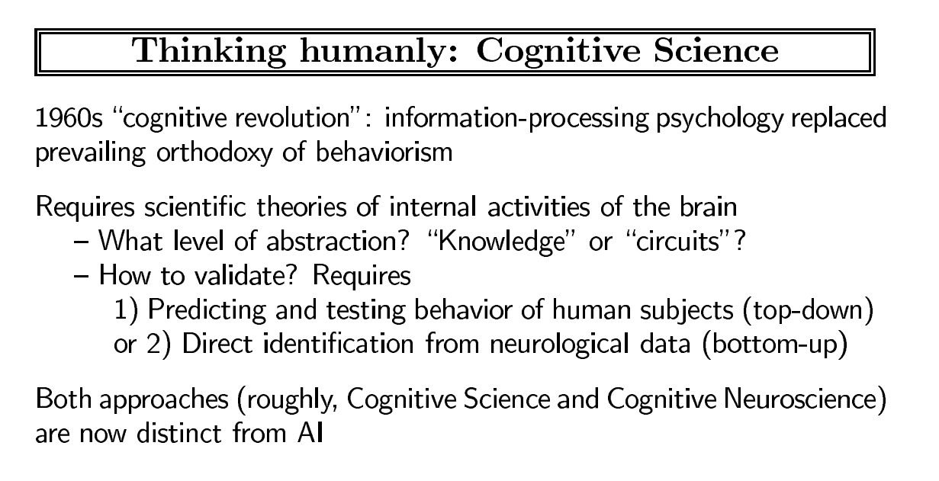

Slide 10
To say that a program thinks like a human, we must know how humans think.
We can learn about human thought in three ways:
Introspection
Psychological experiments
Brain imaging
The interdisciplinary field of cognitive science
Notes:
Introspection—trying to catch our own thoughts as they go by;
Psychological experiments—observing a person in action;
Brain imaging—observing the brain in action.
4.cognitive science brings together computer models from AI and experimental techniques from psychology to construct precise and testable theories of the human mind.

Slide 11
For example, Allen Newell and Herbert Simon, who developed GPS, the “General Problem Solver” (Newell and Simon 1961), were not content merely to have their program solve problems correctly.
They were more concerned with comparing the sequence and timing of its reasoning steps to those of human subjects solving the same problems.
The interdisciplinary field of cognitive science brings together computer models from AI and experimental techniques from psychology to construct precise and testable theories of the human mind.

Slide 12
Video links:
Thinking humanly in artificial intelligence – YouTube
1.1.2 Thinking humanly: The cognitive modeling approach (youtube.com)

Slide 13
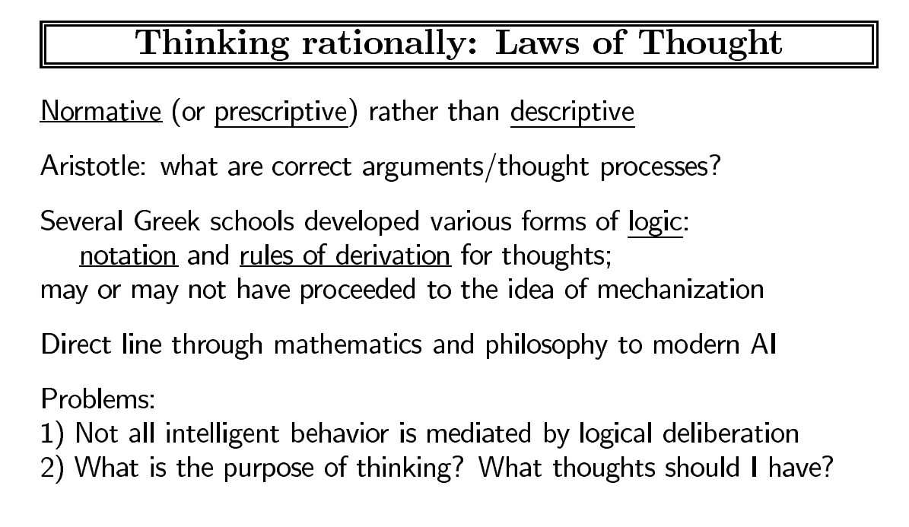
Thinking rationally: The “laws of thought” approach
1.Syllogisms:
The Greek philosopher Aristotle was one of the first to attempt to codify “right thinking.
2. Logicist:
By 1965, programs could, in principle, solve any solvable problem described in logical notation.
3.Probability:
allowing rigorous reasoning with uncertain information.
Notes:
Syllogisms:
The Greek philosopher Aristotle was one of the first to attempt to codify “right thinking. His syllogisms provided patterns for argument structures that always yielded correct conclusions when given correct premises. The canonical example starts with Socrates is a man and all men are mortal and concludes that Socrates is mortal. His syllogisms provided patterns for argument structures that always yielded correct conclusions when given correct premises.
Logicist:
By 1965, programs could, in principle, solve any solvable problem described in logical notation. The so-called logicist tradition within artificial intelligence hopes to build on such programs to create intelligent systems.
Probability:
In principle, it allows the construction of a comprehensive model of rational thought, leading from raw perceptual information to an understanding of how the world works to predictions about the future

Slide 14
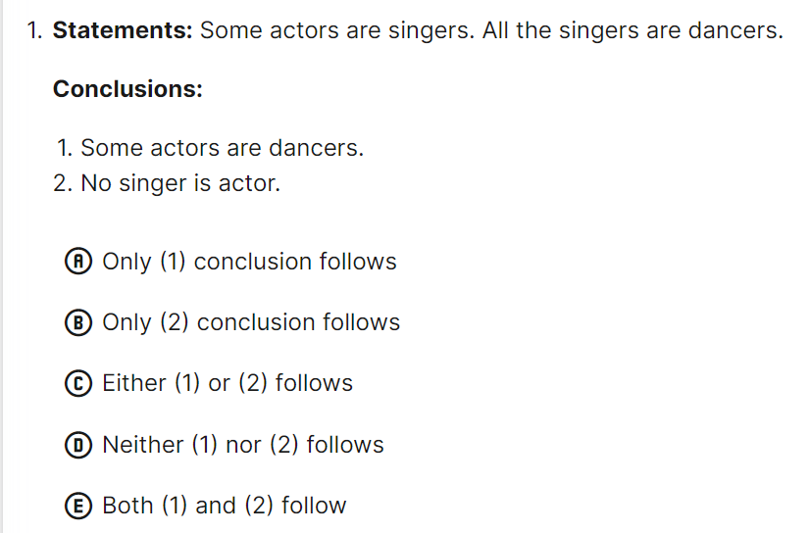
Example for syllogism

Slide 15
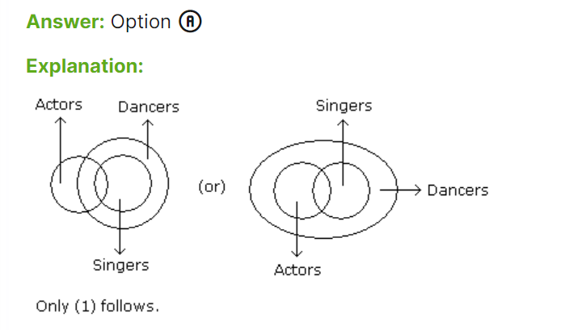
Solution:

Slide 16
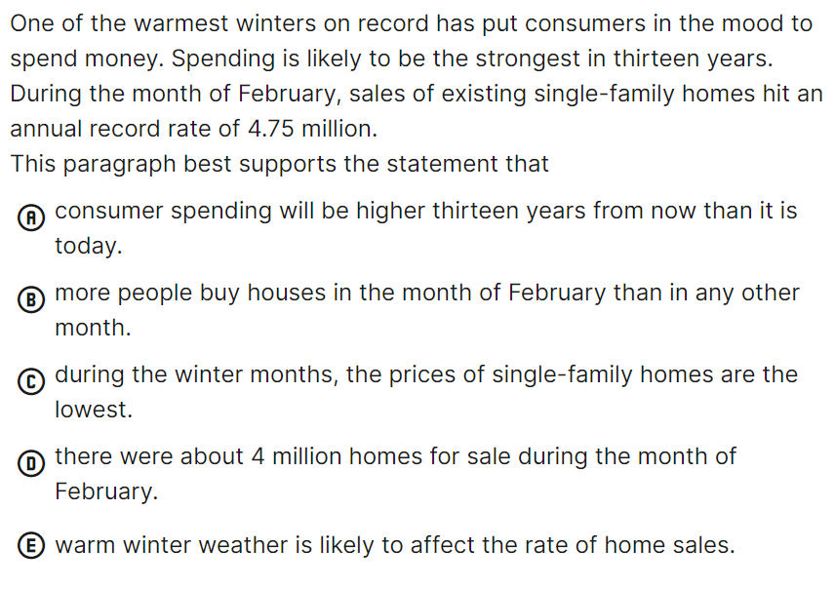
Example for Logicist: Statements and Assumptions
Notes:
Answer: Option E
Explanation:
This is clearly the best answer because the paragraph directly states that warm weather affects consumers inclination to spend. It furthers states that the sales of single-family homes was at an all-time high. There is no support for choice a or c. Choice b is wrong because even though there were high sales for a particular February, this does not mean that sales are not higher in other months. Choice d presents a misleading figure of 4 million. The paragraph states that the record of 4.75 million was at an annual, not a monthly, rate.

Slide 17
Example for Probability
Two players, Sangeet and Rashmi, play a tennis match. The probability of Sangeet winning the match is 0.62. What is the probability that Rashmi will win the match?
Solution: Let S and R denote the events that Sangeeta wins the match and Reshma wins the match, respectively.
The probability of Sangeet to win = P(S) = 0.62
The probability of Rashmi to win = P(R) = 1 – P(S)
= 1 – 0.62 = 0.38

Slide 18
Video links:
1.1.3 Thinking rationally: The "laws of thought" approach – YouTube

Slide 19
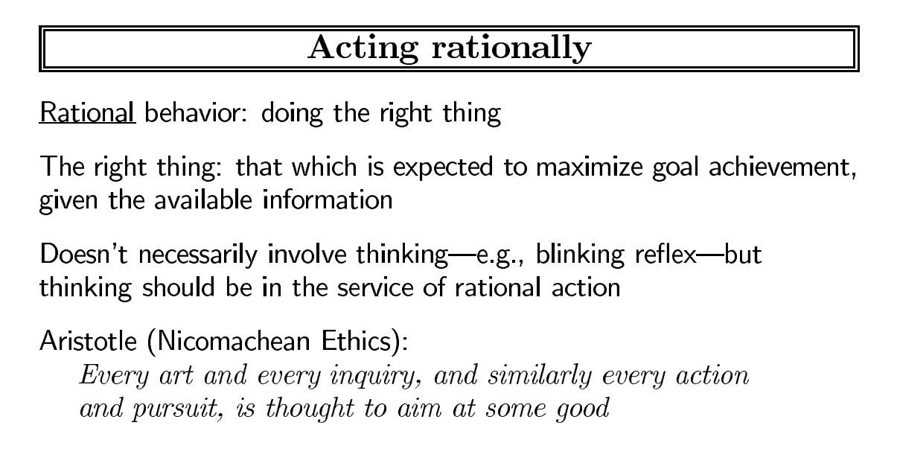

Slide 20
Components:
1.Agent: can be anythink, which
Perceiving its environment through sensors and
Acting upon that environment through actuators
2.Rational agent:
A rational agent is a mathematical model that tries to represent the behavior of an intelligent being, like a person or animal. It uses a set of rules to determine the best course of action for a given situation.
Notes:
1. Rationa Agent:
For example, if you're hungry, you might want to eat something. If you're not hungry any longer, you might stop eating. A rational agent will do this repeatedly until it reaches some goal or decides it's time for bed (or both).
Some rational agents in AI include:
Self-driving cars make decisions based on sensor data and optimize for safety and efficiency.
Game-playing AI, such as AlphaGo, makes decisions based on the game's rules and the board's current state to maximize the chances of winning.
Virtual personal assistants, such as Siri or Alexa, understand natural language commands and take appropriate actions based on the user's request.

Slide 21
3.Do the right thing:
AI has focused on the study and construction of agents that do the right thing.
4.Standard model :
What counts as the right thing is defined by the objective that we provide to the agent. This general paradigm is so pervasive that we might call it the standard model.
5.Limited rationality :acting appropriately when there is not enough time to do all the computations one might like. However, perfect rationality often remains a good starting point for theoretical analysis.

Slide 22
Video link:
1.1.4 Acting rationally: The rational agent approach (youtube.com)
summary
Different Aspects of AI | Acting Humanly | Thinking Humanly | Thinking Rationally |Acting Rationally (youtube.com)

Slide 23
The Foundations of Artificial Intelligence
The foundation Provides the disciplines that contributed ideas, viewpoints and Techniques to AI
1 Philosophy
2.Mathematics and Statistics
3.Economics
4.Neuroscience
5.Phycology
6.Computer Science and Engineering
7.Control Theory and Cybernetics
8.Linguistics

Slide 24
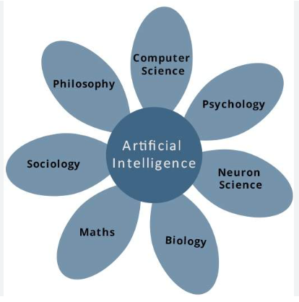

Slide 25
Video Link:
The Foundations of Artificial Intelligence -Unit-1-Introduction to Artificial Intelligence-20A05502T (youtube.com)

Slide 26
The Foundations of Artificial Intelligence
1 Philosophy
Can formal rules be used to draw valid conclusions?
How does the mind arise from a physical brain?
Where does knowledge come from?
How does knowledge lead to action?

Slide 27
Principles of Philosophy
Dualism
Materialism
Empiricism
Induction
Logical positivism
Observation sentence
Confirmation theory
Utilitarianism
Deontological ethics
Notes:
Dualism: Any philosophical theory that states that everything is only composed of two substances. Eg: There is a part of the human mind (or soul or spirit) that is outside of nature, exempt from physical laws.
Materialism: Philosophical Materialism states that everything that truly exists is matter; everything is material, thus all phenomena we see are a result of material interactions.²
Empiricism :the theory that all knowledge is based on experience derived from the senses.eg: Learning to speak: A child learning to speak is based on a lot of experience, trial and error approach
induction, refers to reasoning or argumentation that aims to draw uncertain general conclusions based on specific observations.
logical positivism are the insistence that all views must be verifiable through experiment or observation, and that all arguments must have a clear logical structure.

Slide 28
1.Dualism: Any philosophical theory that states that everything is only composed of two substances. Eg: There is a part of the human mind (or soul or spirit) that is outside of nature, exempt from physical laws.
2.Materialism: Philosophical Materialism states that everything that truly exists is matter; everything is material, thus all phenomena we see are a result of material interactions.
3.Empiricism :the theory that all knowledge is based on experience derived from the senses.eg: Learning to speak: A child learning to speak is based on a lot of experience, trial and error approach
4.Induction, refers to reasoning or argumentation that aims to draw uncertain general conclusions based on specific observations.
5.logical positivism are the insistence that all views must be verifiable through experiment or observation, and that all arguments must have a clear logical structure.

Slide 29
Observation sentence: A method to record the facts from one’s personal point of view, and observation.
Confirmation theory is an attempt to analyze this crucial notion of confirmation based on proofs or evidences.
Utilitarianism is the principle that actions are to be judged by their usefulness in this senses. making decisions that will produce the greatest amount of happiness and joy.
Deontological ethics : Ethical theories that place special emphasis on the relationship between duty and the morality of human actions.

Slide 30
The Foundations of Artificial Intelligence
2. Mathematics :
What are the formal rules to draw valid conclusions?
What can be computed?
How do we reason with uncertain information?
Principles of Mathematics
Formal logic
Probability
Statistics
Algorithm
Incompleteness theorem
Computability
Tractability
NP-completeness
Notes:
Formal logic, also known as mathematical logic, is a subfield of mathematics that explores the formal applications of logic to mathematics
Probability refers to the extent of occurrence of events. When an event occurs like throwing a ball, picking a card from a deck, etc., then there must be some probability associated with that event.
Statistics is a branch of mathematics that uses probability theory to collect, analyse, and interpret quantitative data.
algorithm can be defined as an mathematical problem which can be solved using DSA
Incompleteness theorem:Computability theory deals primarily with the question of the extent to which a problem is solvable on a computer.
Tractability :refers to the ability to perform mathematical calculations to solve a problem
NP-completeness :In computational complexity theory, a problem is NP-complete when: It is a decision problem, meaning that for any input to the problem, the output is either "yes" or "no".

Slide 31
3. Economics
How should we make decisions in accordance with our preferences? How should we do this when others may not go along?
How should we do this when the payoff may be far in the future?
Economics
Decision theory
Operations research
Satisficing
Notes:
Decision theory:Decision theory refers to a range of econometric and statistical tools for analyzing an individual’s choices
Operations research is a discipline that deals with the development and application of analytical methods to improve decision-making.
Satisficing: Satisficing is a decision-making strategy that aims for a satisfactory or adequate result, rather than the optimal solution.

Slide 32
4.Neuroscience
How do brains process information?
Principles of Neuroscience
Neuron
Optogenetics
Brain–machine interface
Singularity
Notes:
Neuron : Neurons are the basic units of the brain. Their main function is to send electrical signals over short and long distances in the body, and they are electrically and chemically excitable.
Optogenetics : Optogenetics is a biological technique to control the activity of neurons or other cell types with light. This is achieved by expression of light-sensitive ion channels, pumps or enzymes specifically in the target cells.
Brain–machine interface : MI refers to types of neurotechnology that create a direct, artificial link between the brain and external devices, allowing users to, s
ay, control the movement of a prosthetic limb or a computer cursor just by thinking about it.
Singularity :singularity is the moment when artificial intelligence will overpass the computational power of the human brain.

Slide 33
4. Psychology
How do humans and animals think and act?
Principles of Psychology
Behaviourism
Cognitive psychology
Intelligence augmentation
Notes:
Behaviourism : Behaviorism is a theory of learning based on the idea that all behaviors are acquired through conditioning, and conditioning occurs through interaction with the environment.
Cognitive psychology : Cognitive psychology is the branch of psychology dedicated to studying how people think. The cognitive perspective in psychology focuses on how the interactions of thinking, emotion, creativity, and problem-solving abilities affect how and why you think the way you do.
Intelligence augmentation: Intelligence augmentation, or IA, is another conceptualization of AI or artificial intelligence. It focuses on the assistive roles of AI with emphasis on the fact that it is meant to enhance human intelligence rather than replace it.

Slide 34
5.Computer engineering
How can we build an efficient computer?
Psychology
Moore’s law
Quantum computing
Notes:
Moore’s law: The observation that the number of transistors on computer chips doubles approximately every two years is known as Moore's Law
Quantum computing : Quantum computing is a multidisciplinary field comprising aspects of computer science, physics, and mathematics that utilizes quantum mechanics to solve complex problems faster than on classical computers.

Slide 35
6.Control theory and cybernetics
How can artifacts operate under their own control?
Principles of Control Theory and Cybernetics.
Control theory
Cybernetics
Homeostatic
Cost function
Notes:
Control theory is a field of control engineering and applied mathematics that deals with the control of dynamical systems in engineered processes and machines. The objective is to develop a model or algorithm governing the application of system inputs to drive the system to a desired state, while minimizing any delay, overshoot, or steady-state error and ensuring a level of control stability.
Cybernetics: the science of communication and control theory that is concerned especially with the comparative study of automatic control systems
Homeostatic: Homeostasis is defined as the property of a system in which variables are regulated so that internal conditions remain stable and relatively constant. Variable being regulated are a receptor, a control center, and an effector.
Cost function :A cost function is the performance measure you want to minimize. Examples of cost include total power consumption, integrated error, and deviation from a reference value of a signal.
Cost function:

Slide 36
7.Linguistics
How does language relate to thought?
Principle of Linguistics
Computational linguistics
Notes:
Computational linguistics :
the branch of linguistics in which the techniques of computer science are applied to the analysis and synthesis of language and speech.

Slide 37
The History of Artificial Intelligence
1.3.1 The inception of artificial intelligence (1943–1956)
1.3.2 Early enthusiasm, great expectations (1952–1969)
1.3.3 A dose of reality (1966–1973)
1.3.4 Expert systems (1969–1986)
1.3.5 The return of neural networks (1986–present)
1.3.6 Probabilistic reasoning and machine learning (1987– present)
1.3.7 Big data (2001–present)
1.3.8 Deep learning (2011–present)

Slide 38
Video links:
A Brief History of Artificial Intelligence (youtube.com)
AI/ML Introduction: Episode #2: History of Artificial Intelligence (AI) (youtube.com)

Slide 39
The State of the Art
Highlights from the 2018 and 2019 Reports
Publications: AI papers increased 20-fold between 2010 and 2019 to about 20,000 a year. The most popular category was machine learning. (Machine learning papers in arXiv.org doubled every year from 2009 to 2017.) Computer vision and natural language processing were the next most popular.
Sentiment: About 70% of news articles on AI are neutral, but articles with positive tone increased from 12% in 2016 to 30% in 2018. The most common issues are ethical: data privacy and algorithm bias.

Slide 40
Highlights from the 2018 and 2019 Reports
3.Students: Course enrollment increased 5-fold in the U.S. and 16-fold internationally from a 2010 baseline. AI is the most popular specialization in Computer Science.
4.Diversity: AI Professors worldwide are about 80% male, 20% female. Similar numbers hold for Ph.D. students and industry hires.
5.Conferences: Attendance at NeurIPS increased 800% since 2012 to 13,500 attendees. Other conferences are seeing annual growth of about 30%.

Slide 41
6.Industry: AI startups in the U.S. increased 20-fold to over 800.
7.Internationalization: China publishes more papers per year than the U.S. and about as many as all of Europe. However, in citation-weighted impact, U.S. authors are 50% ahead of Chinese authors. Singapore, Brazil, Australia, Canada, and India are the fastest growing countries in terms of the number of AI hires.
8.Vision: Error rates for object detection (as achieved in LSVRC, the Large-Scale Visual Recognition Challenge) improved from 28% in 2010 to 2% in 2017, exceeding human performance. Accuracy on open-ended visual question answering (VQA) improved from 55% to 68% since 2015, but lags behind human performance at 83%.

Slide 42
9. Speed: Training time for the image recognition task dropped by a factor of 100 in just the past two years. The amount of computing power used in top AI applications is doubling every 3.4 months.
10. Language: Accuracy on question answering, as measured by F1 score on the Stanford Question Answering Dataset (SQUAD), increased from 60 to 95 from 2015 to 2019; on the SQUAD 2 variant, progress was faster, going from 62 to 90 in just one year. Both scores exceed human-level performance.
11.Human benchmarks: By 2019, AI systems had reportedly met or exceeded human-level performance in chess, Go, poker, Pac-Man, Jeopardy!, ImageNet object detection, speech recognition in a limited domain, Chinese-to-English translation in a restricted domain, Quake III, Dota 2, StarCraft II, various Atari games, skin cancer detection, prostate cancer detection, protein folding, and diabetic retinopathy diagnosis.

Slide 43
The State of the Art : AI Applications
What can AI do today?:Here are some examples:
ROBOTIC VEHICLES:
Legged locomotion:
AUTONOMOUS PLANNING AND SCHEDULING:
MACHINE TRANSLATION:
SPEECH RECOGNITION:
RECOMMENDATIONS:
Game playing:
IMAGE UNDERSTANDING:
MEDICINE:
CLIMATE SCIENCE:
Notes:
Legged locomotion: BigDog, a quadruped robot by Raibert et al. (2008), upended our notions of how robots move—no longer the slow, stiff-legged, side-to-side gait of Hollywood movie robots, but something closely resembling an animal and able to recover when shoved or when slipping on an icy puddle. Atlas, a humanoid robot, not only walks on uneven terrain but jumps onto boxes and does backflips.
AUTONOMOUS PLANNING AND SCHEDULING: A hundred million miles from Earth, NASA’s Remote Agent program became the first on-board autonomous planning program to control the scheduling of operations for a spacecraft (Jonsson et al., 2000).

Slide 44
CHAPTER 2
INTELLIGENT AGENTS

Slide 45
CHAPTER 2:
Introduction, How agents should act, mapping from percept sequences to actions
Agents and Environments, the concept of Rationality
The Nature of Environments, Rational Agent
Structure of intelligent agents: Agent programs Simple reflex agents, model-based
Goal-based agents, utility-based agents and learning agents
Behavior and environment in which a particular agent operates, properties of agents

Slide 46
Agents and Environments
An agent is anything that can be viewed as perceiving its environment through sensors and acting upon that environment through actuators.

